Slide 1
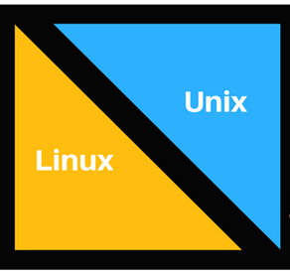
CAP448
UNIX AND LINUX

Slide 2
Topics to be Discussed in this Lecture
Introduction to UNIX
UNIX Architecture
Introduction to LINUX
LINUX based OS Architecture
Difference Between Unix and Linux
Unix Vs Linux Commands

Slide 3
Introduction to UNIX
Unix is very old and is said to be the mother of all operating systems. Linux kernel is also derived from Unix.
The design of Unix systems is based on “Unix Philosophy” which includes the following characteristics:
Usage of plain text for data storage.
Handling devices and some specific kinds of inter-process communication (IPC) as files.
Employing a huge number of software tools.
Multiple small, simple and modular programs which can be threaded together via a command-line interpreter

Slide 4
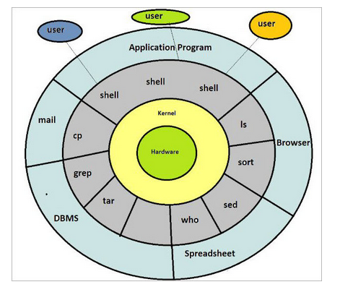
UNIX Architecture

Slide 5
Introduction to LINUX
People do confuse a lot between the terms Unix and Linux and they generally ask questions like “Is Unix Different from Linux?” / “Are Linux and Unix the same thing?” / “Is Linux like Unix?”/ “Is Linux built on Unix?”.
Let me clear your confusion in a one-liner. Linux and Unix are different but they do have a relationship with each other as Linux is derived from Unix.
Linux is not Unix, but it is a Unix-like operating system. Linux system is derived from Unix and it is a continuation of the basis of Unix design. Linux distributions are the most famous and healthiest example of the direct Unix derivatives. BSD (Berkley Software Distribution) is also an example of a Unix derivative.

Slide 6
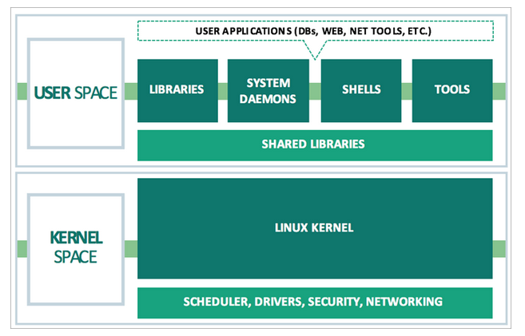
LINUX based OS Architecture

Slide 7
Difference Between Unix and Linux
The major difference between Unix and Linux based operating systems is not in the presentation part, but on how they work internally, i.e. mainly at the kernel part.

Slide 8
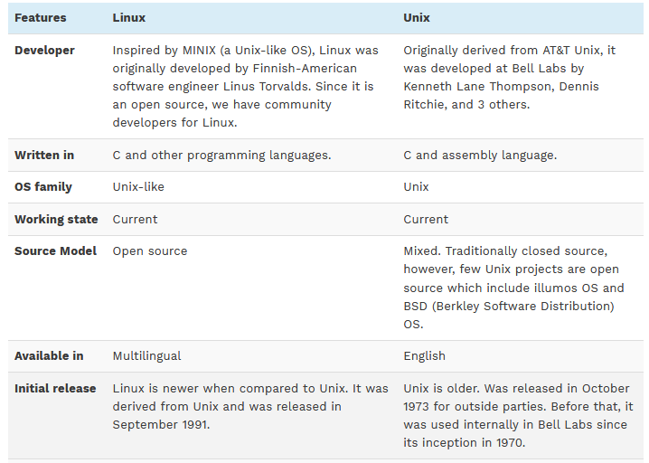

Slide 9
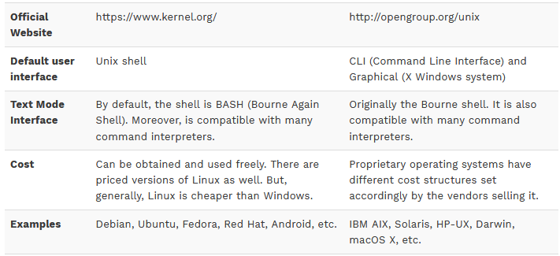

Slide 10
Unix Vs Linux Commands
The terminal commands in Linux distros and Unix operating systems are not exactly the same, but, there are not many differences too.
In Ubuntu/Debian (a Linux OS), we have fdisk, parted, gparted commands for the ‘create’ task. On the other hand, in Solaris (a Unix OS), we have a format, fmthard for the ‘create’ task.

Slide 11


See You in the Next Class
Any Queries…???

